Slide 1

Optimizing Inventory & Sales for Maximum Profitability
Strategic analysis of retail operations to identify opportunities for improved profitability through better pricing, inventory management, and vendor relationships.

Slide 2

Business Challenge
Pricing Efficiency
Vendor Performance
Identify brands requiring promotional or pricing adjustments to maximize revenue.
Determine top vendors contributing to sales and gross profit.
Inventory Turnover
Profitability Analysis
Assess stock movement to reduce holding costs and improve efficiency.
Investigate variance between high and low-performing vendors.

Slide 3

Data Landscape Overview
Dataset Scope
Key Metrics Analyzed
Analysis of 10,692 product records across multiple vendors, brands, and financial metrics.
Purchase Price: $24.39 average
Actual Price: $35.64 average
Total Sales: $42,239 average
Purchase and sales quantities tracked
Gross Profit: $12,132 average
Stock Turnover: 1.71 average
Profit margins and turnover rates calculated
Vendor relationships mapped
Freight and operational costs included

Slide 4

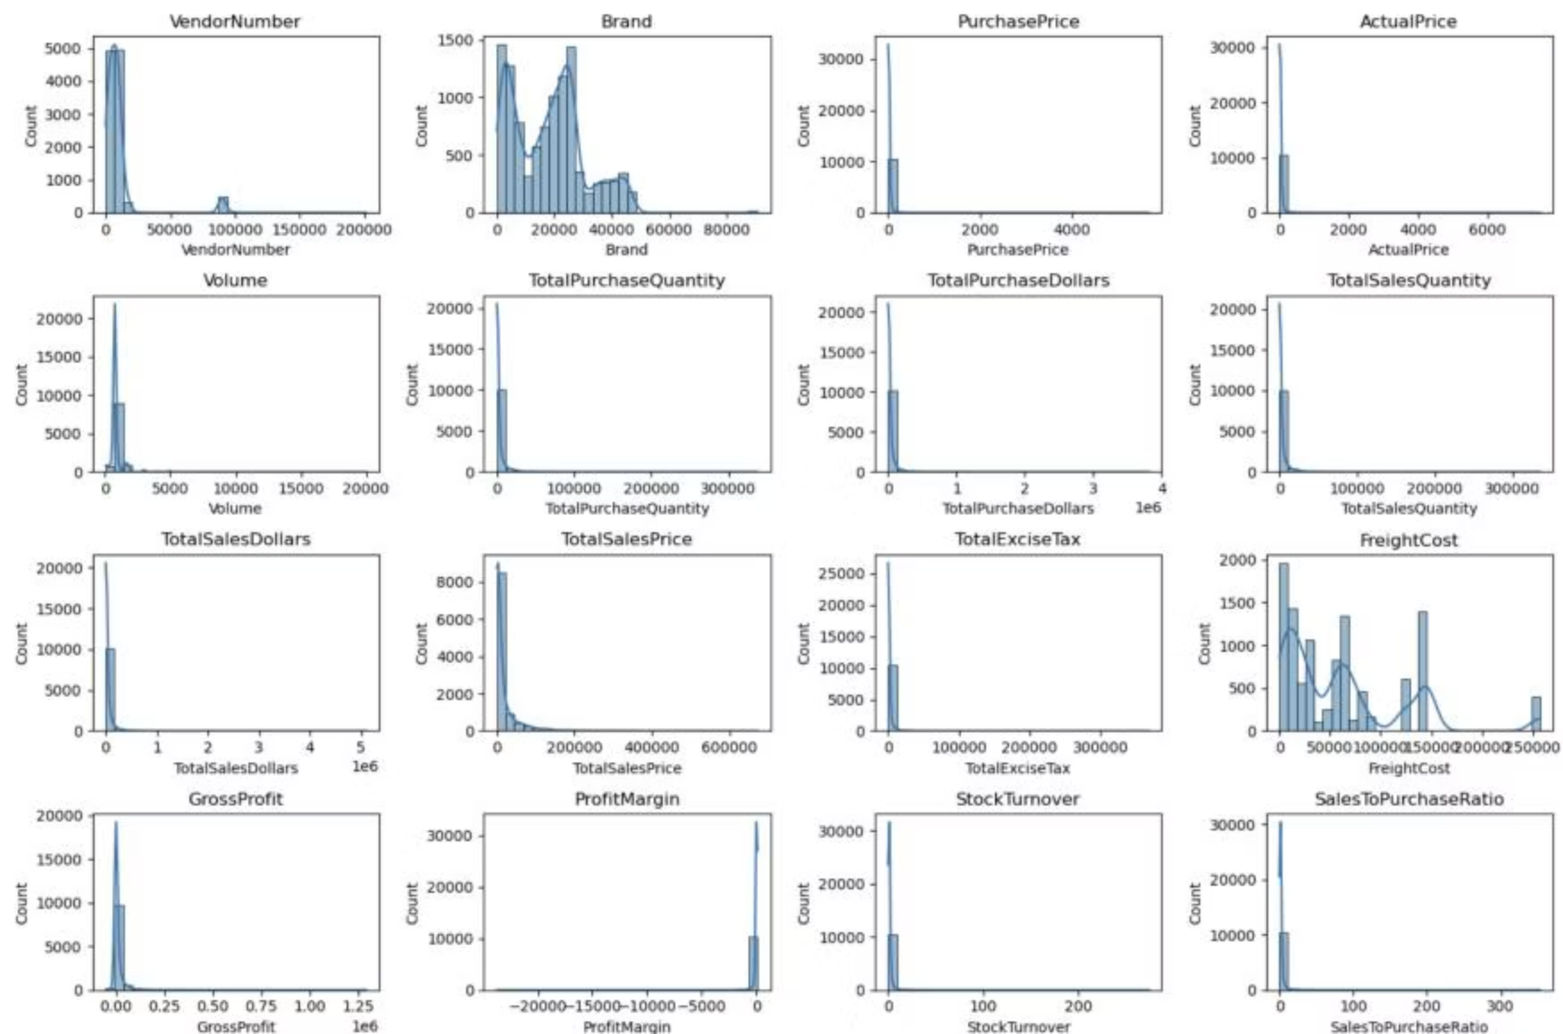
Critical Data Anomalies Detected
1
Negative Gross Profit
Minimum of -$52,002.78 indicates losses from high costs or heavy discounts. Products sold below purchase cost.
2
Zero Sales Products
Some inventory purchased but never sold, indicating slow-moving or obsolete stock causing inefficiencies.
3
Extreme Price Variations
Maximum prices ($5,681.81 purchase, $7,499.99 actual) far exceed means, suggesting premium product offerings.
4
Freight Cost Volatility
Range from $0.09 to $257,032 suggests logistics inefficiencies or erratic shipping costs across products.

Slide 5
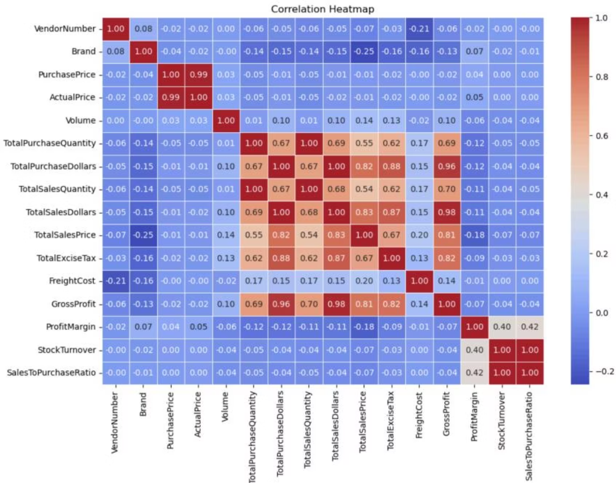
Correlation Insights
Key Relationships Discovered
Purchase-Sales Alignment
Price-Profit Disconnect
Weak correlation between purchase price and sales/profit suggests pricing variations don't significantly impact revenue.
Strong correlation (0.999) between purchase and sales quantities confirms efficient inventory turnover.
Margin Pressure
Negative correlation (-0.179) between sales price and profit margin indicates competitive pricing pressures.

Slide 6

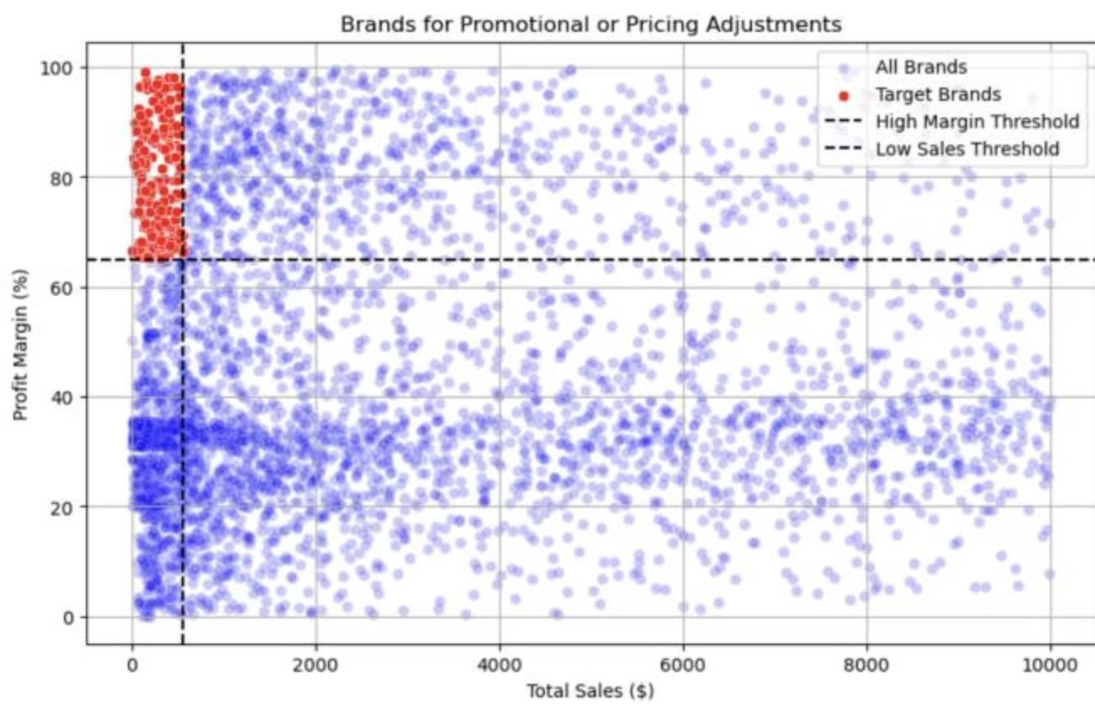
High-Margin, Low-Sales Opportunity
198
66-89%
$560
Target Brands
Profit Margins
Max Sales
Brands with low sales but high profit margins identified for promotional optimization.
Exceptional margins ranging from 66% to 89% across target brands.
Highest sales among target brands, indicating significant volume growth potential.
These brands could benefit from targeted marketing, promotions, or price optimizations to increase volume without compromising profitability.

Slide 7

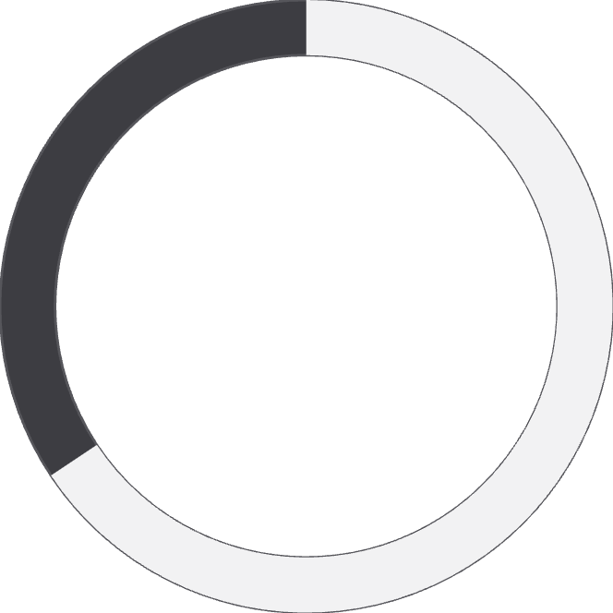
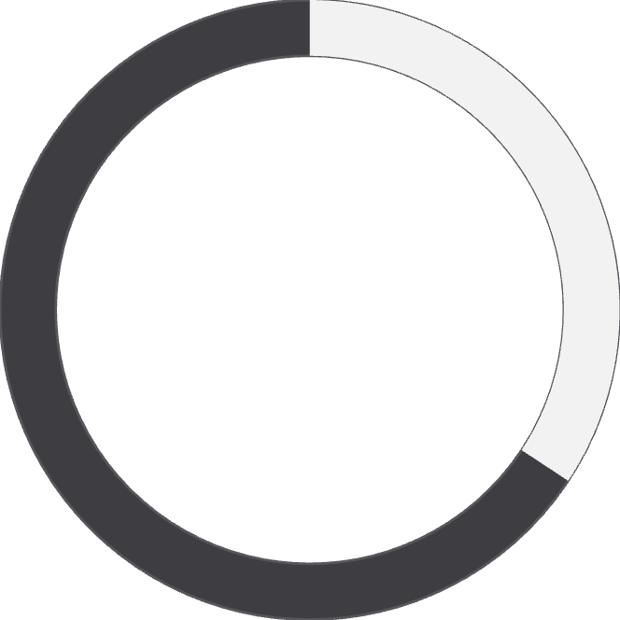

Vendor Concentration Risk
65.69%
34.31%
Top 10 vendors' share of total purchases
All remaining vendors combined
Risk Alert: Over-reliance on a few vendors creates significant supply chain disruption risk. Strategic diversification is essential.
This imbalance in vendor concentration necessitates immediate action to diversify our supply base and mitigate potential vulnerabilities.

Slide 8



Bulk Purchasing Power
Small Orders
$39.06 per unit
Medium Orders
$15.49 per unit
Large Orders
$10.78 per unit
Vendors buying in large quantities receive 72% lower unit costs compared to small orders. Bulk pricing strategies encourage larger orders, increasing total sales while maintaining profitability.

Slide 9

Inventory Turnover Challenge
Slow-Moving Inventory Impact
Top Vendors with Unsold Stock
$2.71M
DIAGEO NORTH AMERICA: $722.21K
JIM BEAM BRANDS: $554.67K
PERNOD RICARD USA: $470.63K
Unsold Capital
WILLIAM GRANT & SONS: $401.96K
Total value tied up in slow-moving inventory
E & J GALLO WINERY: $228.28K
0.62
Lowest Turnover
ALISA CARR BEVERAGES turnover rate
Slow-moving inventory increases storage costs, reduces cash flow efficiency, and affects overall profitability.

Slide 10
Strategic Recommendations
01
02
03
Optimize High-Margin Brands
Diversify Vendor Base
Leverage Bulk Purchasing
Re-evaluate pricing for 198 low-sales, high-margin brands to boost volume without sacrificing profitability.
Reduce dependency on top 10 vendors (currently 65.69%) to mitigate supply chain risks.
Maximize 72% cost savings through strategic bulk orders while optimizing inventory management.
04
05
Address Slow Inventory
Enhance Low-Performer Marketing
Optimize $2.71M in unsold stock through adjusted quantities, clearance sales, or revised storage strategies.
Drive higher sales volumes for vendors with 41.55% margins through improved distribution and marketing.

